Slide 1
61% of First-generation college students choose careers that give back to their communities.
National First-Generation Day Tuesday, November 8th

Slide 2
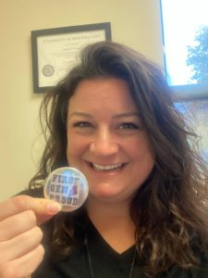
Faculty and Staff
Melissa Clement
“My college journey began the fall after graduating high school. I always knew I wanted to go to college and my family expected it of me, but I did not have a foundation for what it was really going to be like. My first attempt did not work out for me. I was so lost. I didn’t understand how to ask for help and there was so much I did not understand. I remember thinking that it would never be realistic for me to be a college graduate. After taking a break for a few years, I found myself determined to make a future for myself. I wanted to be independent, and I wanted stability. I focused my energy on what I wanted and didn’t let anything get in my way. At times, my goal seemed so far away- I sometimes felt like I didn’t belong. I used that frustration as motivation and focused on what was in my control in the here and now and eventually earned my Master’s Degree. For those who are not first generation, it is easy to minimize all of the little pieces of information that get passed to you along the way. First generation college students learn more than just academics. We learn how to advocate, how to persevere. We are an example for so many that will come after us- our children, siblings, and other college students who may be feeling defeated. When we leave college, we are ready to take on anything! I am so very FIRST GEN PROUD!
First-generation college students are important to the future of Maine because they are paving the way for generations to come.”

Slide 3
77% of KVCC students are First-generation college students.
National First-Generation Day Tuesday, November 8th

Slide 4
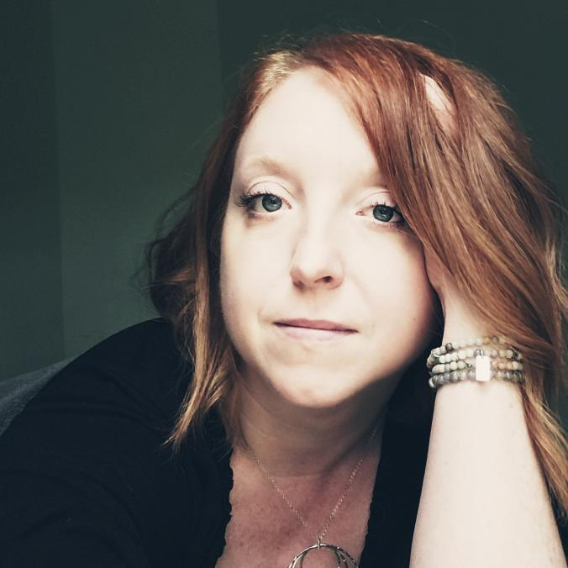
Faculty and Staff
Araminta Matthews
"My mother was a high school dropout due to overcrowding during the Baby Boomer years. She would later get her GED when I started Kindergarten just to show me how important schooling was. My father, a high school graduate, was a self-made engineer who took a high-paying laborer job to break the chain of poverty that held my family in its grip for generations. It is for these two reasons and my parents' unflagging support of me that I was not only able to imagine college was possible for me, but that I could pursue a, ahem, fine arts degree, even.
I obtained my Bachelor of Fine Arts degree in Creative Writing from the University of Maine at Farmington with minors in French and Women’s Studies and then went onto obtain a terminal degree, a Master of Fine Arts in Creative Writing, from National University. Both lovers of books, my parents were very proud of my storytelling abilities and my lifelong learning. I didn’t stop at my MFA, either. I have added many certificates and graduate classes to my CV (resume for people in higher education) over the years—Digital Curation, Global Career Development Facilitator, and Teaching, to name a few.
I have put all these skills to good use as an instructional designer in some form or other, designing strong courses for eLearning, hybrid, and face-to-face environments for the past 12 years. I’ve also professionally published a few books over the years, too. I love KVCC because I can see clearly how everything do helps nurture the next generation of lifelong learners to achieve their goals. I am honored to be a part of such a great institution."

Slide 5
The majority of First-generation college students attend a community college.
National First-Generation Day Tuesday, November 8th

Slide 6
First-generation college students are those whose parents do not hold a Bachelor’s degree.
National First-Generation Day Tuesday, November 8th

Slide 7
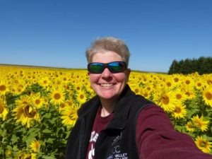
Faculty and Staff
Teresa Smith
“My mom and dad went to work and raised three daughters. They never had the chance to go to college but they were very supportive of all three of us going to college…and we did! I am the first person in my family to earn a Master’s Degree.
As first-generation students, you will often feel that your family doesn’t understand how hard going to college is…that’s when you talk to your support at KVCC. We get it – and we will help. Even though it may seem a struggle at times, know this – Education Changes Lives. I believe that with every fiber of my being. You are the future teachers, healthcare providers and trades men and women of our state. We need you to make the world run, but more importantly, your families need you to be their role models and heroes!”

Slide 8
Joining TRIO is an example of a strategy First-generation college students can utilize to be more successful.
National First-Generation Day Tuesday, November 8th

Slide 9
KVCC’s 2022 Student of the Year was the first in their family to go to college!
National First-Generation Day
Tuesday, November 8th

Slide 10
Faculty and Staff
Landi Wright
“Although neither of my parents held a college degree, they did understand the value of an education; so I was raised with the assumption that I would go to college after high school. I applied and was accepted to a private college in New York. I even went so far as to travel there for a two-day freshman orientation; but ultimately, I chose not to attend college then. Honestly, I was just too afraid. I felt so out of place among the other freshmen at the orientation, like I didn’t belong there. How could I relate to these kids from affluent homes with well-educated parents? How could they ever understand and accept me, a low-income, first-generation student who didn’t have the same background, ideas, experiences, social skills, and opportunities that they had? Years later, I did finally find my way back to college and completed my degree, but I have never forgotten that feeling of not belonging, of not having “all the right stuff” to be a college student. This is what drives me to always strive for excellence when serving students here at KVCC – I want every student who walks into my office to know that there is at least one person here who understands the challenges they face, accepts them where they’re at, and believes that they DO belong here.”

Slide 11
KVCC’s TRIO program has been helping First-gen pioneers since 1993!
National First-Generation Day Tuesday, November 8th

Slide 12
93% of First-gen TRIO students had better than average GPAs in 2021
National First-Generation Day Tuesday, November 8th

Slide 13
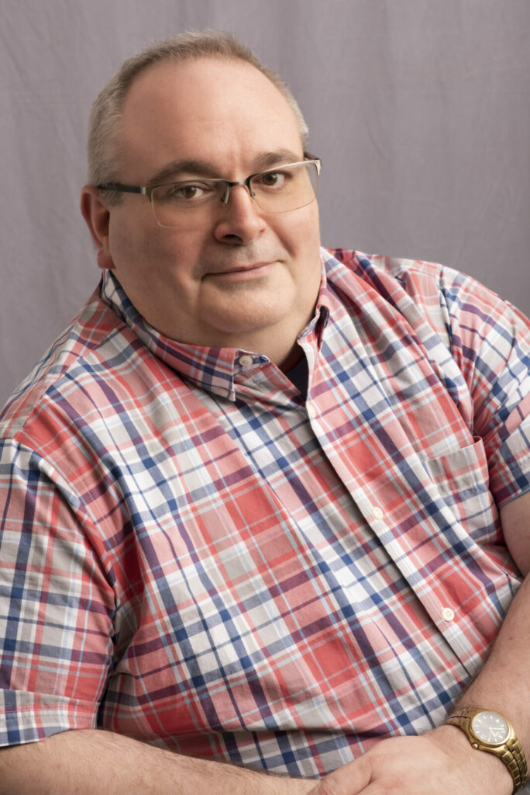
Faculty and Staff
Jim Chapman
“Like several of my colleagues, I was the first in my family to go to college. My mother worked her way up in the hospital from a switchboard operator to the manager of the business office. She experienced the difficulty of advancing without any degree, so for her there was no question: I would be going to college! Fortunately, I loved learning and followed in the footsteps of three uncles who earned their degrees in accounting or management.
I knew I wanted my Master’s degree, and I was afraid that if I stopped at my Baccalaureate, I would never go back. I chose a college and program where I could earn my BS and my MBA together in 5 years. When I started teaching, I was responsible for a lot of technology courses with no real coursework, so I went back for my second Master’s, this time in Computer Education. The courses weren’t always easy, but the reward in the end was so worth it! At the risk of using a worn-out platitude, no education is wasted; even in the worst situations, there is an opportunity to learn something. Keep plugging away and know that I am proud of you!

Slide 14
92% of First-gen TRIO students continued to their second academic year in 2021
National First-Generation Day Tuesday, November 8th

Slide 15
First-generation college students are pioneers! Way to go!
National First-Generation Day Tuesday, November 8th

Slide 16
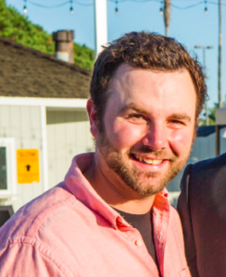
Faculty and Staff
Mike Tardiff
“Colleges and universities are their own cultures. They have their own practices, norms, values, and even economies. Without someone to prepare or mentor you, it’s easy to feel culture shocked and overwhelmed–if you’re brave enough to enroll in the first place! We need more first-generation college students (and graduates) so we can systematically dismantle the many barriers to higher ed. Being the first in your family to fill out the FAFSA or choose a major or transfer or apply for an internship can be daunting. We need more people who can relate to these challenges!”

